Slide 1
Extended Mark-Up Language
XML

Slide 2
XML
XML stands for eXtensible Markup Language.
XML was designed to store and transport data.
XML was designed to be both human- and machine-readable.

Slide 3
XML
XML stands for Extensible Markup Language. It is a text-based markup language derived from Standard Generalized Markup Language (SGML).
XML tags identify the data and are used to store and organize the data, rather than specifying how to display it like HTML tags, which are used to display the data. XML is not going to replace HTML in the near future, but it introduces new possibilities by adopting many successful features of HTML.
Bridge for data exchange on the Web
XML tags are not predefined. You must define your own tags
XML is designed to be self-descriptive

Slide 4
It is a protocol for containing and managing data.
– A family of technologies.
Formatting documents to filtering data
– A philosophy for handling information.
SGML ( Standard Generalized Markup Language) as defined by ISO 8879.
XML is not a language itself. Rather, it’s a metalanguage used for writing other languages, called XML vocabularies.
XHTML is one of those vocabularies.
XML is the most common tool for data transmissions between all sorts of applications.

Slide 5
HTML and XML, I
XML stands for eXtensible Markup Language
HTML is used to mark up text so it can be displayed to users
XML is used to mark up data so it can be processed by computers
HTML describes both structure (e.g. <p>, <h2>, <em>) and appearance (e.g. <br>, <font>, <i>)
XML describes only content, or “meaning”
HTML uses a fixed, unchangeable set of tags
In XML, you make up your own tags

Slide 6
HTML and XML, II
HTML and XML look similar, because they are both SGML languages (SGML = Standard Generalized Markup Language)
Both HTML and XML use elements enclosed in tags (e.g. <body>This is an element</body>)
Both use tag attributes (e.g., <font face="Verdana" size="+1" color="red">)
Both use entities (&lt;, &gt;, &amp;, &quot;, &apos;)
More precisely,
HTML is defined in SGML
XML is a (very small) subset of SGML

Slide 7
HTML and XML, III
HTML is for humans
HTML describes web pages
You don’t want to see error messages about the web pages you visit
Browsers ignore and/or correct as many HTML errors as they can, so HTML is often sloppy
XML is for computers
XML describes data
The rules are strict and errors are not allowed
In this way, XML is like a programming language
Current versions of most browsers can display XML
However, browser support of XML is spotty at best

Slide 8
Characteristics
XML is extensible: XML allows you to create your own self-descriptive tags, or language, that suits your application.
XML carries the data, does not present it: XML allows you to store the data irrespective of how it will be presented.
XML is a public standard: XML was developed by an organization called the World Wide Web Consortium (W3C) and is available as an open standard.

Slide 9
XML Components
Declaration(<?xml version="1.0" encoding="UTF-8" standalone="yes" ?>)
Tags
Elements
Attributes
Comments
Comments cannot appear before XML declaration.
Comments may appear anywhere in a document.
Comments must not appear within attribute values.
Comments cannot be nested inside the other comments.

Slide 10
XML Usage
XML can work behind the scene to simplify the creation of HTML documents for large web sites.
XML can be used to exchange the information between organizations and systems.
XML can be used for offloading and reloading of databases.
XML can be used to store and arrange the data, which can customize your data handling needs.
XML can easily be merged with style sheets to create almost any desired output.
Virtually, any type of data can be expressed as an XML document.

Slide 11
XML Document Example 1
<?xml version="1.0" encoding="UTF-8"?> <note> <to>Tove</to> <from>Jani</from> <heading>Reminder</heading> <body>Don't forget me this weekend!</body> </note>
Result

Slide 12
Understanding XML Syntax
XML languages use tags to mark up text.
<p>Here is an introduction to XML.</p>
The above line is XHTML, but it’s also XML.
XML allows you to construct your own tags, so you could rewrite the previous markup as:
<intro> Here is an introduction to XML. </intro>
In this example, the <intro> tag tells you the purpose of the text that it marks up.
One big advantage of XML is that tags can describe their content—that’s why XML languages are often called self-describing.
The only constraint on XML vocabularies is that they be well-formed.

Slide 13
Well-Formed Documents
XML documents are well-formed if they meet the following criteria:
• The document contains one or more elements.
• The document contains a single document element, which may contain other elements.
• Each element closes correctly.
• Elements are case-sensitive.
• Attribute values are enclosed in quotation marks and cannot be empty.

Slide 14
Understanding the Difference Between Tags and Elements:
The term element describes opening and closing tags as well as any content.
Elements usually contain both an opening and closing tag as well as the content between.
A tag is one part of an element.
Tags start with an opening angle bracket and end with a closing angle bracket.
<intro>Here is an introduction to XML.</intro>

Slide 15
XML Document:
<?xml version="1.0“>
<!-- This XML document describes a DVD library -->
<library>
<DVD id="1">
<title>Breakfast at Tiffany's</title>
<format>Movie</format>
<genre>Classic</genre>
</DVD>
<DVD id="2">
<title>Contact</title>
<format>Movie</format>
<genre>Science fiction</genre>
</DVD>
<DVD id="3">
<title>Little Britain</title>
<format>TV Series</format>
<genre>Comedy</genre>
</DVD>
</library>

Slide 16
XML Document:
The document starts with an XML declaration:
<?xml version=“1.0”>
This declaration is optional and can contain a number of attributes.
This XML document also includes a comment describing its purpose:
<!-- This XML document describes a DVD library -->
The document or root element is called <library>.
The document element contains a number of <DVD> elements, and each <DVD> element contains <title>, <format>, and <genre> elements. The <DVD> element also contains an id attribute

Slide 17
Naming Rules in XML:
XML names cannot start with a number or punctuation.
XML names cannot include spaces.
Don’t include a colon in a name.
XML names are case-sensitive

Slide 18
Structure of an XML Document:
Each XML document is divided into two parts:
Prolog:
Processing
Comments
DTD/Schema
Document:
Elements
Attribute
Text
CDATA
Entity
Comment

Slide 19
Valid XML Documents:
A "Valid" XML document is a "Well Formed" XML document, which also conforms to the rules of a Document Type Definition (DTD)
<?xml version="1.0" encoding="ISO-8859-1"?> <!DOCTYPE note SYSTEM "Note.dtd"> <note> <to>Students</to> <from>faculty</from> <heading>Good Morning</heading> <body>Hello Dear how are you</body> </note>
Note: The DOCTYPE declaration in the example above, is a reference to an external DTD file.

Slide 20
XML-related technologies
DTD (Document Type Definition) and XML Schemas are used to define legal XML tags and their attributes for particular purposes
CSS (Cascading Style Sheets) describe how to display HTML or XML in a browser
XSLT (eXtensible Stylesheet Language Transformations) and XPath are used to translate from one form of XML to another
DOM (Document Object Model), SAX (Simple API for XML, and JAXP (Java API for XML Processing) are all APIs for XML parsing

Slide 21
Document Type Definition(DTD)
The Document Type Definition(DTD) describes a model of the structure of the content of an XML document. This model says what elements must be present, which ones are optional, what their attributes are and how they can be structured in relation to each other.
DTDs check vocabulary and validity of the structure of XML documents against grammatical rules of appropriate XML language.
An XML DTD can be either specified inside the document, or it can be kept in a separate document and then liked separately.

Slide 22
Internal DTD
A DTD is referred to as an internal DTD if elements are declared within the XML files. To refer it as internal DTD, standalone attribute in XML declaration must be set to yes. This means, the declaration works independent of external source.
Syntax
<!DOCTYPE root-element [element-declarations]>
where root-element is the name of root element and element-declarations is where you declare the elements.

Slide 23
<?xml version="1.0" encoding="UTF-8" standalone="yes" ?>
<!DOCTYPE address [
<!ELEMENT address (name,company,phone)> <!ELEMENT name (#PCDATA)>
<!ELEMENT company (#PCDATA)>
<!ELEMENT phone (#PCDATA)>
]>
<address>
<name>Tanmay Patil</name>
<company>TutorialsPoint</company>
<phone>(011) 123-4567</phone>
</address>

Slide 24
External DTD
In external DTD elements are declared outside the XML file. They are accessed by specifying the system attributes which may be either the legal .dtd file or a valid URL. To refer it as external DTD, standalone attribute in the XML declaration must be set as no. This means, declaration includes information from the external source.
Syntax
<!DOCTYPE root-element SYSTEM "file-name">

Slide 25
<?xml version="1.0" encoding="UTF-8" standalone="no" ?>
<!DOCTYPE address SYSTEM "address.dtd">
<address>
<name>Tanmay Patil</name>
<company>TutorialsPoint</company>
<phone>(011) 123-4567</phone>
</address>
The content of the DTD file address.dtd are as shown:
<!ELEMENT address (name,company,phone)>
<!ELEMENT name (#PCDATA)>
<!ELEMENT company (#PCDATA)>
<!ELEMENT phone (#PCDATA)>

Slide 26
PCDATA
PCDATA means parsed character data.
Think of character data as the text found between the start tag and the end tag of an XML element.
PCDATA is text that WILL be parsed by a parser. The text will be examined by the parser for entities and markup.
Tags inside the text will be treated as markup and entities will be expanded.
However, parsed character data should not contain any &, <, or > characters; these need to be represented by the &amp; &lt; and &gt; entities, respectively.

Slide 27
CDATA
CDATA means character data.
CDATA is text that will NOT be parsed by a parser. Tags inside the text will NOT be treated as markup and entities will not be expanded.

Slide 28
Elements with Children (sequences)
Elements with one or more children are declared with the name of the children elements inside parentheses:
<!ELEMENT element-name (child1)>
Or
<!ELEMENT element-name (child1,child2,...).
Example:
<!ELEMENT note (to,from,heading,body)>
When children are declared in a sequence separated by commas, the children must appear in the same sequence in the document. In a full declaration, the children must also be declared, and the children can also have children. The full declaration of the "note" element is:
<!ELEMENT note (to,from,heading,body)>
<!ELEMENT to (#PCDATA)>
<!ELEMENT from (#PCDATA)>
<!ELEMENT heading (#PCDATA)>
<!ELEMENT body (#PCDATA)>

Slide 29
Declaring Only One Occurrence of an Element
<!ELEMENT element-name (child-name)> Example: <!ELEMENT note (message)>
The example above declares that the child element "message" must occur once, and only once inside the "note" element.

Slide 30
Declaring Minimum One Occurrence of an Element
<!ELEMENT element-name (child-name+)> Example: <!ELEMENT note (message+)>
The + sign in the example above declares that the child element "message" must occur one or more times inside the "note" element.

Slide 31
Declaring Zero or More Occurrences of an Element
<!ELEMENT element-name (child-name*)> Example: <!ELEMENT note (message*)>
The * sign in the example above declares that the child element "message" can occur zero or more times inside the "note" element.

Slide 32
Declaring Zero or One Occurrences of an Element
<!ELEMENT element-name (child-name?)> Example: <!ELEMENT note (message?)>
The ? sign in the example above declares that the child element "message" can occur zero or one time inside the "note" element.

Slide 33
Declaring either/or Content
<!ELEMENT note(to,from,header,(message|body))>
The example above declares that the "note" element must contain a "to" element, a "from" element, a "header" element, and either a "message" or a "body" element.

Slide 34
Empty Content
This is a special case of element declaration. This element declaration does not contain any content. These are declared with the keyword EMPTY.
Syntax
<!ELEMENT elementname EMPTY >
Example
<?xml version="1.0"?>
<!DOCTYPE hr[ <!ELEMENT address EMPTY> ]><address />
In this example address is declared as an empty element. The markup for address element would appear as <address />.

Slide 35
ANY Element Content
<!ELEMENT elementname ANY>
Here, the ANY keyword indicates that text (PCDATA) and/or any elements declared within the DTD can be used within the content of the <elementname> element. They can be used in any order any number of times. However, the ANY keyword does not allow you to include elements that are not declared within the DTD.
Example
Following is a simple example demonstrating the element declaration with ANY content:
<?xml version="1.0" encoding="UTF-8" standalone="yes" ?>
<!DOCTYPE address [ <!ELEMENT address ANY>]>
<address> Here's a bit of sample text</address>

Slide 36
Attribute declaration
Attribute declaration is very much similar to element declarations in many ways except one; instead of declaring allowable content for elements, you declare a list of allowable attributes for each element. These lists are called ATTLIST declaration.
Syntax
<!ATTLIST element-name attribute-name attribute-type attribute-value>
In the above syntax
The DTD attributes start with <!ATTLIST keyword if the element contains the attribute.
element-name specifies the name of the element to which the attribute applies.
attribute-name specifies the name of the attribute which is included with the element-name.
attribute-type defines the type of attributes.
attribute-value takes a fixed value that the attributes must define.

Slide 37
Example
Below is a simple example for attribute declaration in DTD:
<?xml version = "1.0"?>
<!DOCTYPE address [
<!ELEMENT address ( name )>
<!ELEMENT name ( #PCDATA )>
<!ATTLIST name id CDATA #REQUIRED> ]>
<address>
<name id="123">Tanmay Patil</name>
</address>

Slide 38
Attribute Value Declaration
Within each attribute declaration, you must specify how the value will appear in the document. You can specify if an attribute:
can have a default value
can have a fixed value
is required
is implied

Slide 39
Default Values
It contains the default value. The values can be enclosed in single quotes(') or double quotes(")
Syntax
<!ATTLIST element-name attribute-name attribute-type "default-value">
<?xml version = "1.0"?>
<!DOCTYPE address [
<!ELEMENT address ( name )>
<!ELEMENT name ( #PCDATA )>
<!ATTLIST name id CDATA "0"> ]>
<address>
<name id="123"> Tanmay Patil </name>
</address>

Slide 40
FIXED Values
#FIXED keyword followed by the fixed value is used when you want to specify that the attribute value is constant and cannot be changed. A common use of fixed attributes is specifying version numbers.
Syntax
<!ATTLIST element-name attribute-name attribute-type #FIXED "value" >

Slide 41
REQUIRED values
Whenever you want specify that an attribute is required, use #REQUIRED keyword.
Syntax
<!ATTLIST element-name attribute-name attribute-type #REQUIRED>
Example
<?xml version = "1.0
DOCTYPE address
[<!ELEMENT address ( name )>
<!ELEMENT name ( #PCDATA )>
<!ATTLIST name id CDATA #REQUIRED> ]>
<address>
<name id="123"> Tanmay Patil </name>
</address>
In this example we have used #REQUIRED keyword to specify that the attribute id must be provided for the element-name name

Slide 42
IMPLIED Values
When declaring attributes you must always specify a value declaration. If the attribute you are declaring has no default value, has no fixed value, and is not required, then you must declare that the attribute as implied. Keyword #IMPLIED is used to specify an attribute as implied.
Syntax
<!ATTLIST element-name attribute-name attribute-type #IMPLIED>
where #IMPLIED is an attribute type defined.
Example
<?xml version = "1.0"?>
<!DOCTYPE address [
<!ELEMENT address ( name )>
<!ELEMENT name ( #PCDATA )>
<!ATTLIST name id CDATA #IMPLIED> ]>
<address>
<name />
</address>
In this example we have used the keyword #IMPLIED as we do not want to specify any attributes to be included in element name. It is optional.

Slide 43
Entity Declaration
<?xml version="1.0" encoding="UTF-8" standalone="yes"?>
<!DOCTYPE address [
<!ELEMENT address (#PCDATA)>
<!ENTITY name "Tanmay patil">
<!ENTITY company "TutorialsPoint">
<!ENTITY phone_no "(011) 123-4567">]>
<address>
&name;
&company;
&phone_no;
</address>

Slide 44
XML Schema
XML Schema is commonly known as XML Schema Definition (XSD). It is used to describe and validate the structure and the content of XML data. XML schema defines the elements, attributes and data types. Schema element supports Namespaces. It is similar to a database schema that describes the data in a database.

Slide 45
Example
<?xml version = "1.0" encoding = "UTF-8"?>
<xs:schema xmlns:xs = "http://www.w3.org/2001/XMLSchema">
<xs:element name = "contact">
<xs:complexType>
<xs:sequence>
<xs:element name = "name" type = "xs:string" /> <xs:element name = "company" type = "xs:string" />
<xs:element name = "phone" type = "xs:int" /> </xs:sequence>
</xs:complexType>
</xs:element>
</xs:schema>

Slide 46
XML - Namespaces
A Namespace is a set of unique names. Namespace is a mechanisms by which element and attribute name can be assigned to a group. The Namespace is identified by URI(Uniform Resource Identifiers).
Namespace Declaration
A Namespace is declared using reserved attributes. Such an attribute name must either be xmlns or begin with xmlns: shown as below −
<element xmlns:name = "URL">
Syntax
The Namespace starts with the keyword xmlns.
The word name is the Namespace prefix.
The URL is the Namespace identifier.

Slide 47
Elements
Elements are the building blocks of XML document. An element can be defined within an XSD as follows −
<xs:element name = "x" type = "y"/>

Slide 48
Simple Type
Simple type element is used only in the context of the text. Some of the predefined simple types are: xs:integer, xs:boolean, xs:string, xs:date.
For example −
<xs:element name = "phone_number" type = "xs:int" />

Slide 49
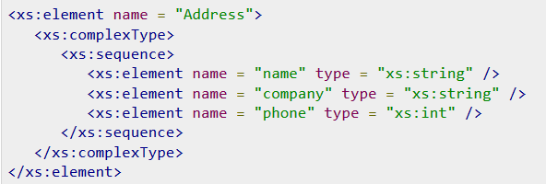
Complex Type
A complex type is a container for other element definitions. This allows you to specify which child elements an element can contain and to provide some structure within your XML documents.
For example −

Slide 50
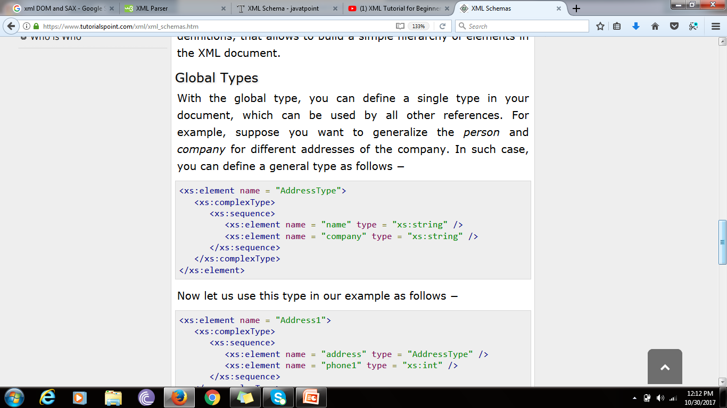
Global Type
With the global type, you can define a single type in your document, which can be used by all other references. For example, suppose you want to generalize the person and company for different addresses of the company. In such case, you can define a general type as follows −

Slide 51
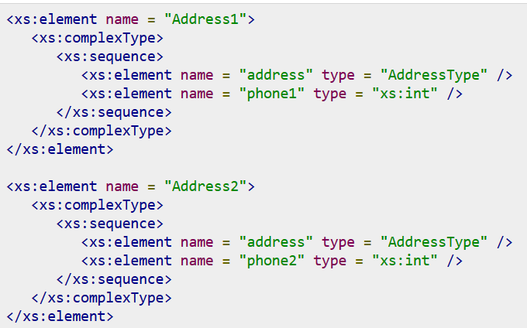
Example
Notes:
Instead of having to define the name and the company twice (once for Address1 and once for Address2), we now have a single definition. This makes maintenance simpler, i.e., if you decide to add "Postcode" elements to the address, you need to add them at just one place.

Slide 52
XML Technology
Xlink
Xpath
Xpointer
xslt

Slide 53
xlink
xLink is used to create hyperlinks in XML documents.
XLink is used to create hyperlinks within XML documents
Any element in an XML document can behave as a link
With XLink, the links can be defined outside the linked files
XLink is a W3C Recommendation
<?xml version="1.0" encoding="UTF-8"?> <homepages xmlns:xlink="http://www.w3.org/1999/xlink"> <homepage xlink:type="simple" xlink:href="https://www.webtechnolgy.com">Visit W3</homepage> <homepage xlink:type="simple" xlink:href="http://www.w3.org">Visit W3C</homepage> </homepages>

Slide 54
XSL
which stands for EXtensible Stylesheet Language. It is similar to XML as CSS is to HTML.
Need for XSL
In case of HTML document, tags are predefined such as table, div, and span; and the browser knows how to add style to them and display those using CSS styles. But in case of XML documents, tags are not predefined. In order to understand and style an XML document, World Wide Web Consortium (W3C) developed XSL which can act as XML based Stylesheet Language.
An XSL document specifies how a browser should render an XML document.
Following are the main parts of XSL −
XSLT
XPath − used to navigate XML document.
XSL-FO − used to format XML document.

Slide 55
What is XSLT
XSLT, Extensible Stylesheet Language Transformations, provides the ability to transform XML data from one format to another automatically.
How XSLT Works
An XSLT stylesheet is used to define the transformation rules to be applied on the target XML document. XSLT stylesheet is written in XML format. XSLT Processor takes the XSLT stylesheet and applies the transformation rules on the target XML document and then it generates a formatted document in the form of XML, HTML, or text format. This formatted document is then utilized by XSLT formatter to generate the actual output which is to be displayed to the end-user.

Slide 56
Advantages
Independent of programming. Transformations are written in a separate xsl file which is again an XML document.
Output can be altered by simply modifying the transformations in xsl file. No need to change any code. So Web designers can edit the stylesheet and can see the change in the output quickly.

Slide 57
students.xml, which is required to be transformed into a well-formatted HTML document.
<?xml version = "1.0"?>
<class>
<student rollno = "393">
<firstname>Dinkar</firstname>
<lastname>Kad</lastname>
<nickname>Dinkar</nickname>
<marks>85</marks>
</student>
<student rollno = "493">
<firstname>Vaneet</firstname>
<lastname>Gupta</lastname>
<nickname>Vinni</nickname>
<marks>95</marks>
</student>
<student rollno = "593">
<firstname>Jasvir</firstname>
<lastname>Singh</lastname>
<nickname>Jazz</nickname>
<marks>90</marks>
</student> </class>

Slide 58
Step 1: Create XSLT document
<?xml version = "1.0" encoding = "UTF-8"?>
<!-- xsl stylesheet declaration with xsl namespace: Namespace tells the xlst processor about which element is to be processed and which is used for output purpose only --> <xsl:stylesheet version = "1.0" xmlns:xsl = "http://www.w3.org/1999/XSL/Transform">
<!-- xsl template declaration: template tells the xlst processor about the section of xml document which is to be formatted. It takes an XPath expression. In our case, it is matching document root element and will tell processor to process the entire document with this template. -->
<xsl:template match = "/">
<!-- HTML tags Used for formatting purpose. Processor will skip them and browser will simply render them. -->

Slide 59
Step 1: Create XSLT document
<html> <body>
<h2>Students</h2>
<table border = "1">
<tr bgcolor = "#9acd32">
<th>Roll No</th>
<th>First Name</th>
<th>Last Name</th>
<th>Nick Name</th> <th>Marks</th> </tr>
<!-- for-each processing instruction Looks for each element matching the XPath expression -->
<xsl:for-each select="class/student">
<tr>
<td> <!-- value-of processing instruction process the value of the element matching the XPath expression -->
<xsl:value-of select = "@rollno"/> </td>
<td><xsl:value-of select = "firstname"/></td> <td><xsl:value-of select = "lastname"/></td> <td><xsl:value-of select = "nickname"/></td> <td><xsl:value-of select = "marks"/></td> </tr>
</xsl:for-each>
</table>
</body>
</html>
</xsl:template> </xsl:stylesheet>

Slide 60
Step 2: Link the XSLT Document to the XML Document
<?xml version = "1.0"?>
<?xml-stylesheet type = "text/xsl" href = "students.xsl"?>
<class>
...
</class>

Slide 61
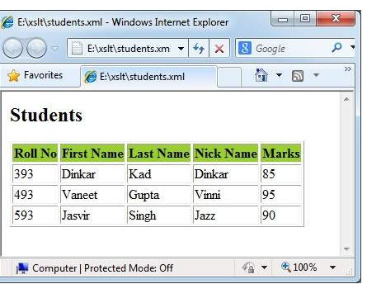

Slide 62
<xsl:for-each> tag applies a template repeatedly for each node.
Declaration
<xsl:for-each> element
<xsl:for-each select = Expression > </xsl:for-each>

Slide 63
<xsl:if>
<xsl:if> tag specifies a conditional test against the content of nodes.
Declaration
<xsl:if test = boolean-expression >
</xsl:if>
eg. <xsl:for-each select = "class/student">
<xsl:if test = "marks > 90"> <tr>
<td><xsl:value-of select = "@rollno"/></td> <td><xsl:value-of select = "firstname"/></td> <td><xsl:value-of select = "lastname"/></td> <td><xsl:value-of select = "nickname"/></td> <td><xsl:value-of select = "marks"/></td>
</tr> </xsl:if> </xsl:for-each>

Slide 64
<xsl:choose> tag
It specifies a multiple conditional tests against the content of nodes in conjunction with the <xsl:otherwise> and <xsl:when> elements.
<xsl:template match = "/">
<html> <body> <h2>Students</h2>
<table border = "1"> <tr bgcolor = "#9acd32">
<th>Roll No</th> <th>First Name</th> <th>Last Name</th> <th>Nick Name</th> <th>Marks</th> <th>Grade</th> </tr> <xsl:for-each select = "class/student">
<tr>
<td><xsl:value-of select = "@rollno"/></td>
<td><xsl:value-of select = "firstname"/></td>
<td><xsl:value-of select = "lastname"/></td>
<td><xsl:value-of select = "nickname"/></td>
<td><xsl:value-of select = "marks"/></td>
<td> <xsl:choose>
<xsl:when test = "marks > 90"> High </xsl:when>
<xsl:when test = "marks > 85"> Medium </xsl:when>
<xsl:otherwise> Low </xsl:otherwise>
</xsl:choose> </td>
</tr>
</xsl:for-each>
</table>
</body>
</html>
</xsl:template>
</xsl:stylesheet>

Slide 65
Namespaces
The namespace URI is not used by the parser to look up information. The purpose of using an URI is to give the namespace a unique name.
However, companies often use the namespace as a pointer to a web page containing namespace information.
Uniform Resource Identifier (URI)
A Uniform Resource Identifier (URI) is a string of characters which identifies an Internet Resource.
The most common URI is the Uniform Resource Locator (URL) which identifies an Internet domain address. Another, not so common type of URI is the Universal Resource Name (URN).
Default Namespaces
Defining a default namespace for an element saves us from using prefixes in all the child elements. It has the following syntax:
xmlns="namespaceURI"
This XML carries HTML table information:
<table xmlns="http://www.w3.org/TR/html4/"> <tr> <td>Apples</td> <td>Bananas</td> </tr> </table>

Slide 66
Namespaces
XSLT is a language that can be used to transform XML documents into other formats.
The XML document below, is a document used to transform XML into HTML.
The namespace "http://www.w3.org/1999/XSL/Transform" identifies XSLT elements inside an HTML document

Slide 67
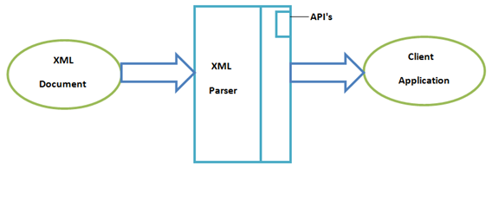
XML Parsers
An XML parser is a software library or package that provides interfaces for client applications to work with an XML document. The XML Parser is designed to read the XML and create a way for programs to use XML.
XML parser validates the document and check that the document is well formatted.
Types of XML Parsers:
DOM
SAX

Slide 68
DOM
A DOM document is an object which contains all the information of an XML document. It is composed like a tree structure. The DOM Parser implements a DOM API. This API is very simple to use.
Features of DOM Parser
A DOM Parser creates an internal structure in memory which is a DOM document object and the client applications get information of the original XML document by invoking methods on this document object.
DOM Parser has a tree based structure.
Advantages
1) It supports both read and write operations and the API is very simple to use.
2) It is preferred when random access to widely separated parts of a document is required.
Disadvantages
1) It is memory inefficient. (consumes more memory because the whole XML document needs to loaded into memory).
2) It is comparatively slower than other parsers.

Slide 69
SAX (Simple API for XML)
A SAX Parser implements SAX API. This API is an event based API.
Features of SAX Parser
It does not create any internal structure.
Clients does not know what methods to call, they just overrides the methods of the API and place his own code inside method.
It is an event based parser, it works like an event handler in Java.
Advantages
1) It is simple and memory efficient.
2) It is very fast and works for huge documents.
Disadvantages
1) It is event-based so its API is less intuitive.
2) Clients never know the full information because the data is broken into pieces.

Slide 70
Difference between DOM and SAX
1) DOM parser loads whole XML document in memory while SAX only loads a small part of the XML file in memory.
2) DOM parser is faster than SAX because it access whole XML document in memory.
3) SAX parser in Java is better suitable for large XML file than DOM Parser because it doesn't require much memory.
4) DOM parser works on Document Object Model while SAX is an event based XML parser.

